Slide 1

Python Day 4

Slide 2
Objectives
Input
Reading a file
Writing in a file
Importance
CSV
JSON
Exercises on input and outputs

Slide 3
Input

Slide 4
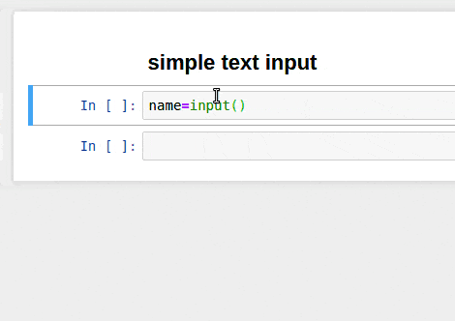
Input
To be useful, a program usually needs to communicate with the user by obtaining input data and displaying result data back.
Input may come directly from the user via the keyboard, or from some external source like a file or database

Slide 5
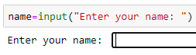
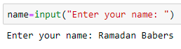
Reading Input From the Keyboard – input()
input() pauses program execution to allow the user to type in a line of input from the keyboard.
Once the user presses the Enter key, all characters typed are read and returned as a string:

Slide 6
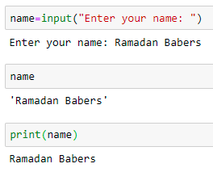
input() - Example
input() always returns a string.

Slide 7
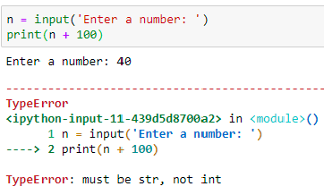
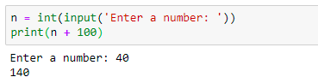
input() – Example2
If you want a numeric type, then you need to convert the string to the appropriate type with the int(), float(), or complex() built-in functions:

Slide 8
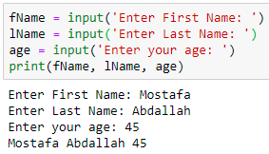
sep - Keyword Argument
Adding the keyword argument sep=<str> causes objects to be separated by the string <str> instead of the default single space
You can specify any arbitrary string as the separator with the sep= keyword.

Slide 9
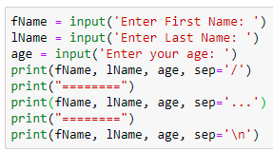
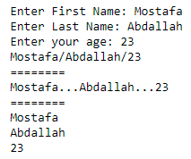
sep - Keyword Argument - Examples

Slide 10
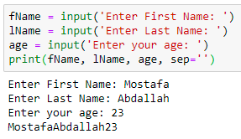
sep - Keyword Argument - Examples
To squish objects together without any space between them, specify sep=‘ ‘

Slide 11
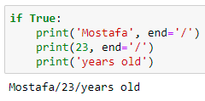
end - Keyword Argument
The keyword argument end=<str> causes output to be terminated by <str> instead of the default newline

Slide 12
Reading a file

Slide 13
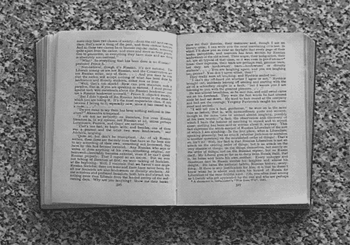
Why are we so interested in working with files?
The data that we work with is stored in files, so if we're going to write useful programs to get the data out of those files and into our programs (and vice versa).

Slide 14
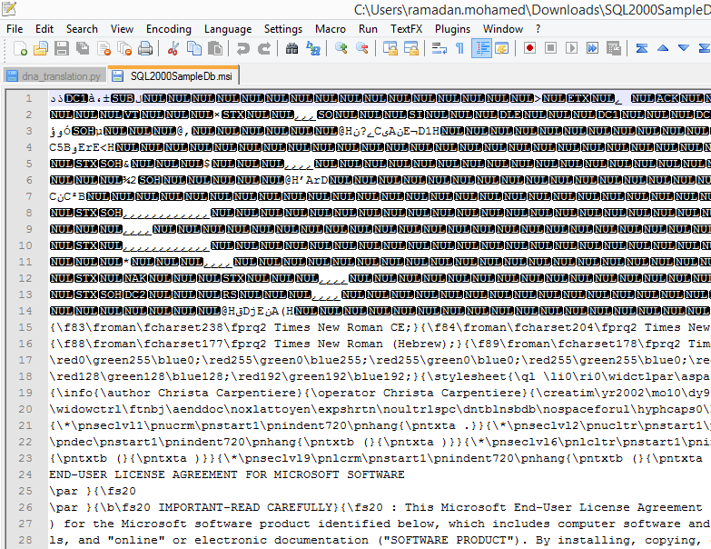
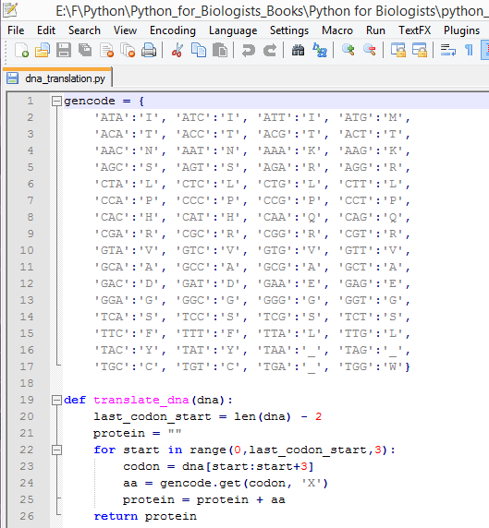
Files Types
If you get an error or a warning from your text editor, or
the file displays as a collection of indecipherable characters, then it's binary
Ex. HTML audio, video and image files
the file displays without any problem,
then it's text
Ex. HTML files and .txt files

Slide 15
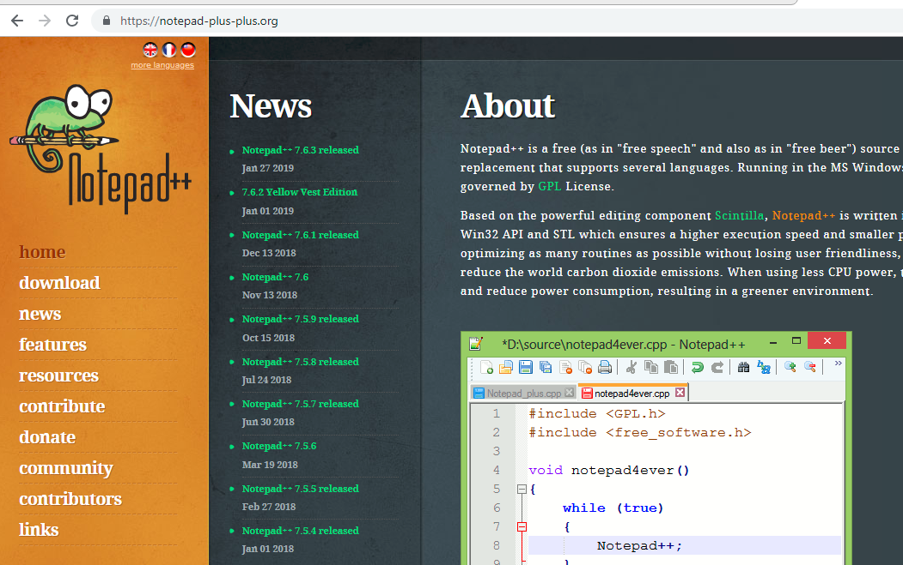
Notepad ++
You can use Notepad ++
to check the files
https://notepad-plus-plus.org/

Slide 16
File - Operations
Open
Read
Close
return whole file as a string, then you can do whatever
Leaving too many files not closed may cause problems

Slide 17
Using open() to read a file
open() function takes one argument – a string which contains the name of the file and its path – and returns a file object:
A file object is a new type (as str and number)
it represents a file on your computer's hard drive.
most of our interaction will be through methods.

Slide 18
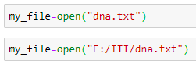
Using open() to read a file (cont.)
open()
function
Name of the file
Path of the file
File object
Default path
Defined path
Notes:
Take care about backslash \ and slash / in file path

Slide 19
read()
when we're working with file objects most of our interaction will be through methods.
Ex: read(), write(), rstrip()
read()
method
No arguments
string
Can be stored in variable
Treat it like any other str.
Ex: print

Slide 20
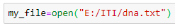
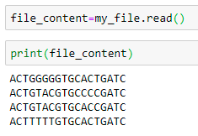
read() – (cont.)
Read input.txt file

Slide 21
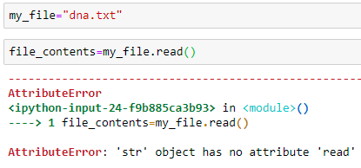
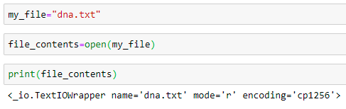
Common errors
read is a method that only works on file objects.
You need to read before print

Slide 22
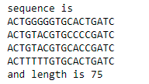
Read the DNA sequence from the file and print its length
Expected output

Slide 23
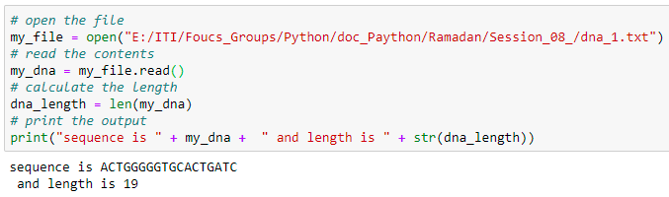
Read the DNA sequence from the file and print its length (Solution)
Why the result in 2 lines
???

Slide 24
rstrip()
rstrip() is a method for removing new lines from the end of a file,
rstrip()
method
argument to rstrip is itself a string so needs to be enclosed in quotes
one string argument which is the character that you want to remove.

Slide 25
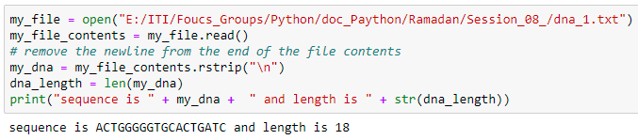
rstrip() - Example

Slide 26
close()
close()
method
no arguments
doesn't return any useful value

Slide 27
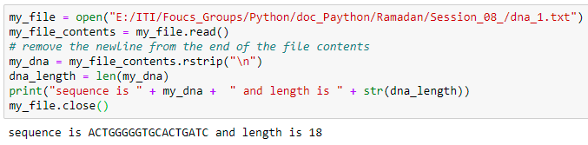
close() – Example

Slide 28
Writing in a file

Slide 29
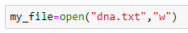
Opening files for writing
Default value
"r" for reading,
"w" for writing,
"a" for appending.

Slide 30
Opening files for writing (cont.)
The difference between "w" and "a"
If we open a file that already exists using the mode "w",
then we will overwrite the current contents with whatever data we write to it.
If we open an existing file with the mode "a",
it will add new data onto the end of the file, but will not remove any existing content.
If there doesn't already exist a file with the specified name,
then "w" and "a" behave identically –
they will both create a new file to hold the output.

Slide 31
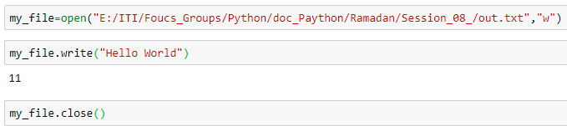
write()
write()
method
a single string argument
print the string to the file.
Number of characters

Slide 32
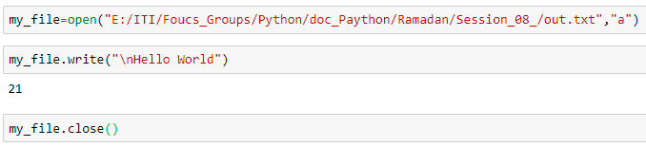
Append to file

Slide 33
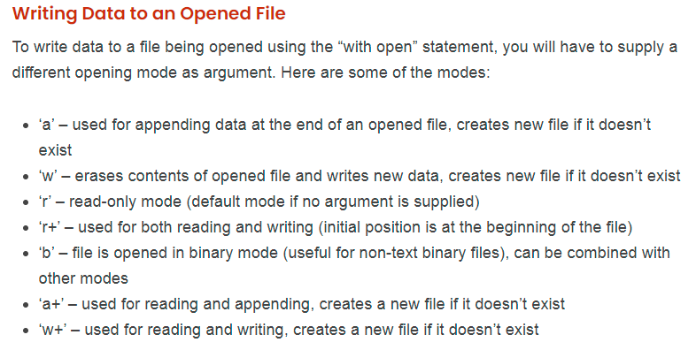
More Information
https://linuxhint.com/how_to_read_write_text_files/

Slide 34
Importance
https://realpython.com/python-modules-packages/

Slide 35
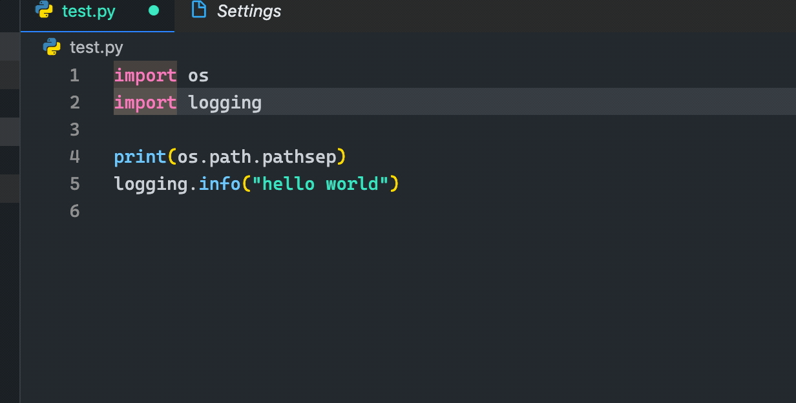
Import Statement
Python code is organized into both modules and packages.
In Python, you use the import keyword to make code in one module available in another. Imports in Python are important for structuring your code effectively.
Using imports properly will make you more productive, allowing you to reuse code while keeping your projects maintainable.

Slide 36
Basic Python import
Modules
Packages
An object that serves as an organizational unit of Python code. Modules have a namespace containing arbitrary Python objects. Modules are loaded into Python by the process of importing
A Python module which can contain submodules or recursively, subpackages. Technically, a package is a Python module with an __path__ attribute.

Slide 37
Python Modules
A module’s contents are accessed with the import statement.
create a file that contains legitimate Python code and then give the file a name with a .py extension.

Slide 38
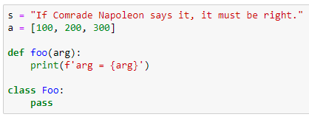
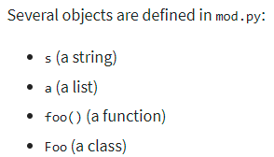
Module - Example
create a file called mod.py containing the following:

Slide 39
The Module Search Path
You can put the module file in any directory of your choice and then modify sys.path at run-time so that it contains that directory.
For example, in our example, you could put mod.py in directory C:\Users\ramadan.mohamed\Desktop\EPITA\Python\8 and then issue the following statements:
Notes:
To know the default path of python
import sys
sys.path
The result will be as:
['', 'C:\\Users\\ramadan.mohamed\\AppData\\Local\\Continuum\\anaconda3\\python36.zip', 'C:\\Users\\ramadan.mohamed\\AppData\\Local\\Continuum\\anaconda3\\DLLs', 'C:\\Users\\ramadan.mohamed\\AppData\\Local\\Continuum\\anaconda3\\lib', 'C:\\Users\\ramadan.mohamed\\AppData\\Local\\Continuum\\anaconda3', 'C:\\Users\\ramadan.mohamed\\AppData\\Local\\Continuum\\anaconda3\\lib\\site-packages', 'C:\\Users\\ramadan.mohamed\\AppData\\Local\\Continuum\\anaconda3\\lib\\site-packages\\win32', 'C:\\Users\\ramadan.mohamed\\AppData\\Local\\Continuum\\anaconda3\\lib\\site-packages\\win32\\lib', 'C:\\Users\\ramadan.mohamed\\AppData\\Local\\Continuum\\anaconda3\\lib\\site-packages\\Pythonwin', 'C:\\Users\\ramadan.mohamed\\AppData\\Local\\Continuum\\anaconda3\\lib\\site-packages\\IPython\\extensions', 'C:\\Users\\ramadan.mohamed\\.ipython']
===================================================
After append the path of mod.py file to the sys path
sys.path.append(r'C:\Users\ramadan.mohamed\Desktop\EPITA\Python\8')
sys.path
The result will be as:
['', 'C:\\Users\\ramadan.mohamed\\AppData\\Local\\Continuum\\anaconda3\\python36.zip', 'C:\\Users\\ramadan.mohamed\\AppData\\Local\\Continuum\\anaconda3\\DLLs', 'C:\\Users\\ramadan.mohamed\\AppData\\Local\\Continuum\\anaconda3\\lib', 'C:\\Users\\ramadan.mohamed\\AppData\\Local\\Continuum\\anaconda3', 'C:\\Users\\ramadan.mohamed\\AppData\\Local\\Continuum\\anaconda3\\lib\\site-packages', 'C:\\Users\\ramadan.mohamed\\AppData\\Local\\Continuum\\anaconda3\\lib\\site-packages\\win32', 'C:\\Users\\ramadan.mohamed\\AppData\\Local\\Continuum\\anaconda3\\lib\\site-packages\\win32\\lib', 'C:\\Users\\ramadan.mohamed\\AppData\\Local\\Continuum\\anaconda3\\lib\\site-packages\\Pythonwin', 'C:\\Users\\ramadan.mohamed\\AppData\\Local\\Continuum\\anaconda3\\lib\\site-packages\\IPython\\extensions', 'C:\\Users\\ramadan.mohamed\\.ipython', 'C:\\Users\\ramadan.mohamed\\Desktop\\EPITA\\Python\\8']
Note that the last line will include the new path we added ---- 'C:\\Users\\ramadan.mohamed\\Desktop\\EPITA\\Python\\8
=================================================================================

Slide 40
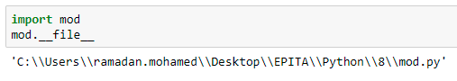
The Module Search Path (cont.)
Once a module has been imported, you can determine the location where it was found with the module’s __file__ attribute:

Slide 41
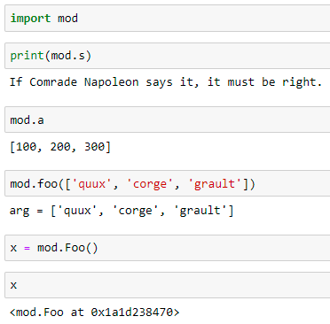
Module – Example (cont.)
The mod.py objects can be accessed by importing the module as follows:

Slide 42
CSV
https://realpython.com/python-csv/

Slide 43
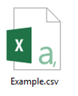
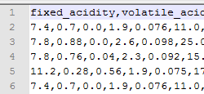
WHAT IS A CSV FILE ?
A CSV file (Comma Separated Values file) is a type of plain text file that uses specific structuring to arrange tabular data.
Because it’s a plain text file, it can contain only actual text data—in other words, printable ASCII or Unicode characters.
The structure of a CSV file is given away by its name. Normally, CSV files use a comma to separate each specific data value.
Notes:
Notice how each piece of data is separated by a comma. Normally, the first line identifies each piece of data—in other words, the name of a data column. Every subsequent line after that is actual data and is limited only by file size constraints.
In general, the separator character is called a delimiter, and the comma is not the only one used. Other popular delimiters include the tab (\t), colon (:) and semi-colon (;) characters. Properly parsing a CSV file requires us to know which delimiter is being used.

Slide 44
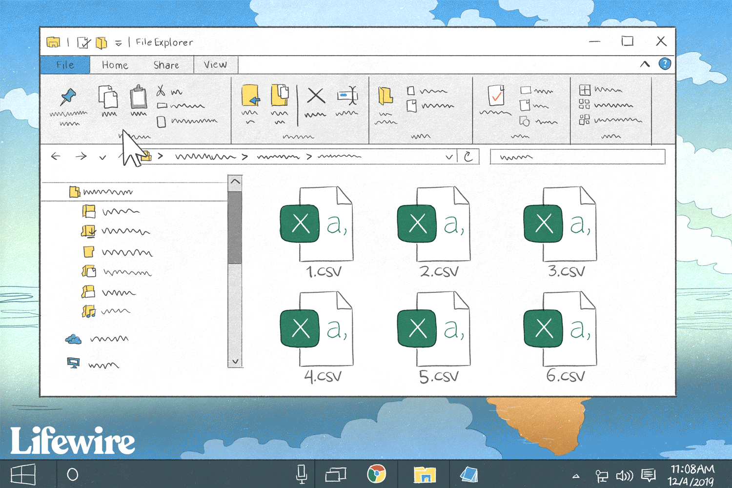
Reading CSV Files With csv
Reading from a CSV file is done using the reader object.
The CSV file is opened as a text file with Python’s built-in open() function, which returns a file object.
This is then passed to the reader, which does the heavy lifting.

Slide 45
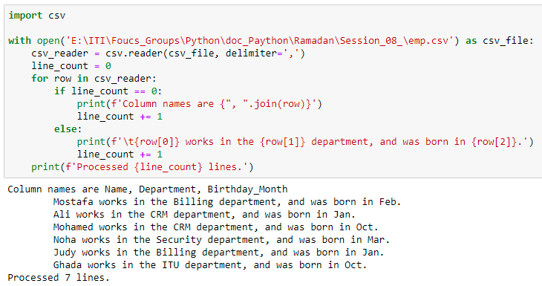
Read csv file - Example
Notes:
Each row returned by the reader is a list of String elements containing the data found by removing the delimiters. The first row returned contains the column names, which is handled in a special way.

Slide 46

Reading CSV Files Into a Dictionary With csv
We can read CSV data directly into a dictionary (technically, an Ordered Dictionary) as well.

Slide 47
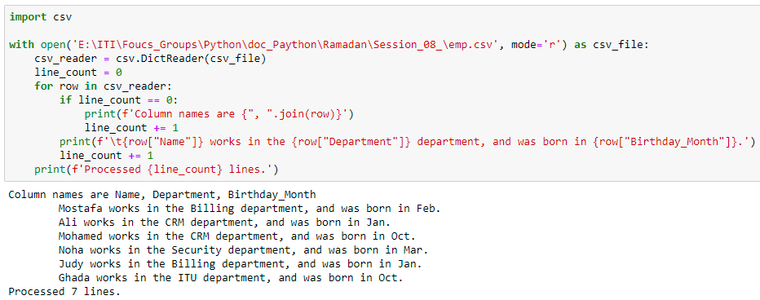
Reading CSV Files Into a Dictionary - Example
Notes:
Where did the dictionary keys come from? The first line of the CSV file is assumed to contain the keys to use to build the dictionary. If you don’t have these in your CSV file, you should specify your own keys by setting the fieldnames optional parameter to a list containing them.

Slide 48
Optional Python CSV reader Parameters
The reader object can handle different styles of CSV files by specifying additional parameters, some of which are shown below:
delimiter specifies the character used to separate each field. The default is the comma (',').
quotechar specifies the character used to surround fields that contain the delimiter character. The default is a double quote (' " ').
For more info: https://docs.python.org/3/library/csv.html?highlight=csv#csv-fmt-params
Notes:
quotechar specifies the character used to surround fields that contain the delimiter character. The default is a double quote (' " ').
Will be clear in slide (Writing CSV Files With csv - example)

Slide 49
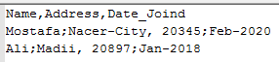
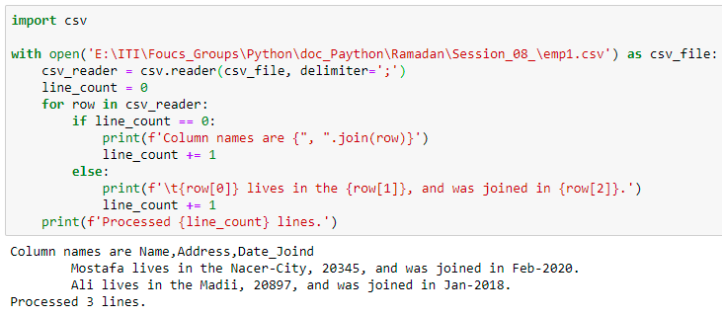
delimiter

Slide 50

Writing CSV Files With csv
We can also write to a CSV file using a writer object and the .write_row() method

Slide 51
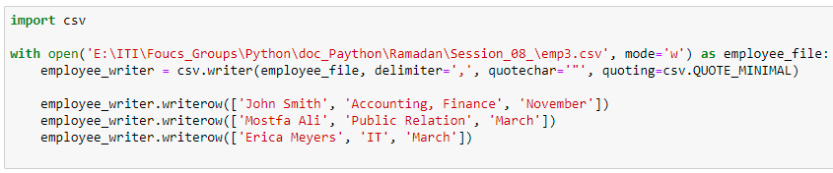
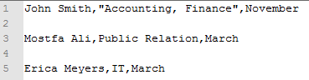
Writing CSV Files With csv - Example
Notes:
Notes
Using quotechar=‘”’ ----- will use “ and “ for field that contains delimiter , ---- as shown in ‘Accounting, finance’
w ---- mode is write (will create file if is not exists) and overwrite on file (delete all data in file and write the new data) if the file exists )
a ----- mode is append

Slide 52
quoting optional parameter
csv.QUOTE_MINIMAL, then .writerow() will quote fields only if they contain the delimiter or the quotechar. This is the default case.
csv.QUOTE_ALL, then .writerow() will quote all fields.
csv.QUOTE_NONNUMERIC, then .writerow() will quote all fields containing text data and convert all numeric fields to the float data type.
csv.QUOTE_NONE, then .writerow() will escape delimiters instead of quoting them. In this case, you also must provide a value for the escapechar optional parameter.

Slide 53
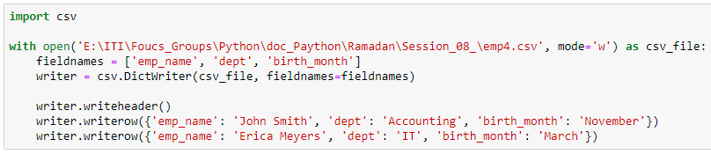
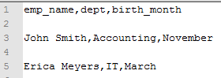
Writing CSV File From a Dictionary With csv Example
Notes:
Unlike DictReader, the fieldnames parameter is required when writing a dictionary.
This makes sense, when you think about it: without a list of fieldnames, the DictWriter can’t know which keys to use to retrieve values from your dictionaries. It also uses the keys in fieldnames to write out the first row as column names.

Slide 54
Reading CSV Files With pandas
pandas is highly recommended if you have a lot of data to analyze.
pandas is an open-source Python library that provides high performance data analysis tools and easy to use data structures.
pandas is available for all Python installations, but it is a key part of the Anaconda distribution and works extremely well in Jupyter notebooks

Slide 55
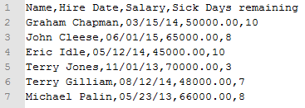
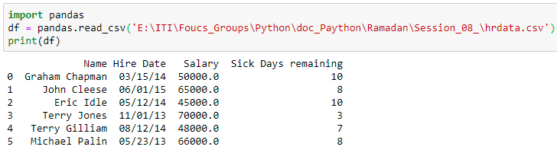
Reading CSV Files With pandas - Example
pandas.read_csv() opens, analyzes, and reads the CSV file provided, and stores the data in a DataFrame
Notes:
First, pandas recognized that the first line of the CSV contained column names, and used them automatically. I call this Goodness.
However, pandas is also using zero-based integer indices in the DataFrame. That’s because we didn’t tell it what our index should be.
Further, if you look at the data types of our columns , you’ll see pandas has properly converted the Salary and Sick Days remaining columns to numbers, but the Hire Date column is still a String. This is easily confirmed in interactive mode

Slide 56
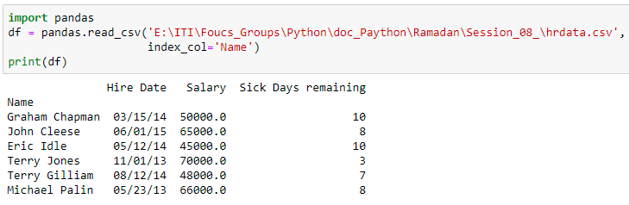
Panda - index_col optional parameter
To use a different column as the DataFrame index, add the index_col optional parameter:

Slide 57
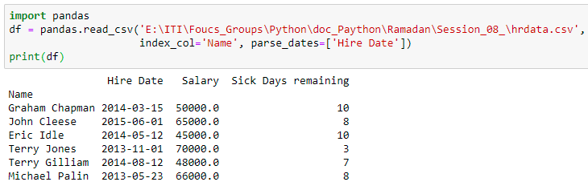
Panda - parse_dates optional parameter
You can force pandas to read data as a date with the parse_dates optional parameter

Slide 58
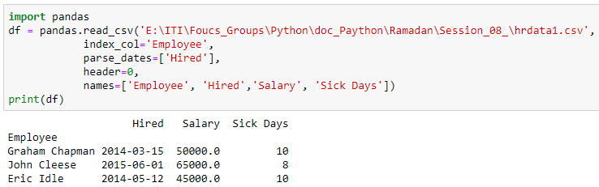
Panda - names optional parameter
If your CSV files doesn’t have column names in the first line, you can use the names optional parameter to provide a list of column names.
Notes:
You can also use this if you want to override the column names provided in the first line. In this case, you must also tell pandas.read_csv() to ignore existing column names using the header=0 optional parameter:

Slide 59
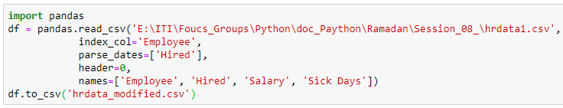

Writing CSV Files With pandas
Writing a DataFrame to a CSV file is just as easy as reading one in.
The only difference between this code and the reading code is that the print(df) call was replaced with df.to_csv() , providing the file name. The new CSV file looks like this:

Slide 60
JSON
https://realpython.com/python-json/#a-very-brief-history-of-json

Slide 61

Brief History of JSON
JOSN: JavaScript Object Notation was inspired by a subset of the JavaScript programming language dealing with object literal syntax.
The community at large adopted JSON because it’s easy for both humans and machines to create and understand.
JSON is supposed to be readable by anyone who’s used a C-style language, and Python is a C-style language
Python comes with a built-in package called json for encoding and decoding JSON data.

Slide 62


JSON and XML
JSON is a data exchange format similar to XML
Ex. Address record in JSON and XML
Notes:
The data exchenge format in JSON similar to XML
In JSON we have curly brackets for open and close the record
Also keys or references as name, address and phone
In XML we have tags instead of keys
JSON is a lightweight format compared to XML

Slide 63

JSON supports primitive types
JSON supports primitive types, like strings and numbers, as well as nested lists and objects.

Slide 64
Serialization and Deserialization
Serialization
Deserialization
The process of encoding JSON
This term refers to the transformation of data into a series of bytes (hence serial) to be stored or transmitted across a network.
Is the reciprocal process of decoding data that has been stored or delivered in the JSON standard.

Slide 65


Serializing JSON
What happens after a computer processes lots of information? It needs to take a data dump.
Accordingly, the json library exposes the dump() method for writing data to files.
There is also a dumps() method (pronounced as “dump-s”) for writing to a Python string.

Slide 66


Create Address Book - Example
JSON is just a concept of format which it is implemented by different languages
We create dictionary include two records

Slide 67

Create Address Book – Example (dumps())
Import JSON
Using dumps()
Print string
Notes:
At first we must import json module
dumps() take dictionary object as input and dumping it as a string
Then we can print the string using print
The output of print will be in json format (i.e. keys and values)

Slide 68


Create Address Book – Example (write())
To write the dictionary into a file
Notes:
It is good practice to use the 'with' keyword when dealing with file objects. This has the advantage that the file is properly closed after its suite finishes, even if an exception is raised on the way. It is also much shorter than writing equivalent try-finally blocks.
The data appear in txt file with json format

Slide 69


Create Address Book – Example (read())
To read the dictionary into a file as a string object
Notes:
Here s is string
We read the whole file as an string object

Slide 70


Create Address Book – Example (loads())
To read the dictionary into a file as a dictionary
Notes:
We used here loads() and to use it we must import json
If we check the type of book here we will find it is a dictionary type.
In the pervious slide the type of book (s) was string

Slide 71


Create Address Book – Example (select specific info)
To read specific record
To read specific info (phone number)

Slide 72

Create Address Book – Example (read all records)
To read all the records in a file

Slide 73
THANKS!
ANY QUESTIONS?

